Slide 1



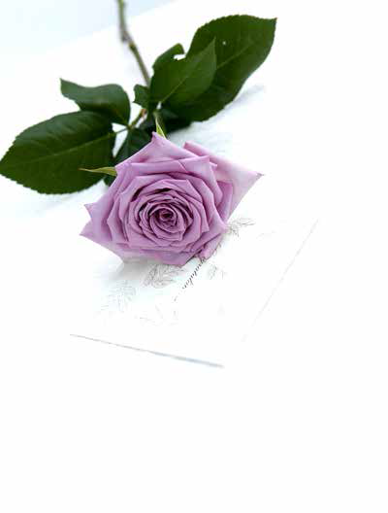
Text
A MARRIAGE
VALENTINE
HE WISHES FOR THE CLOTHS OF HEAVEN

Slide 2




Text
A MARRIAGE
R. S. Thomas
We met
under a shower
of bird-notes.
Fifty years passed,
love’s moment
in a world in
servitude to time.

Slide 3
Text
She was young;
I kissed with my eyes
closed and opened
them on her wrinkles.
“Come,” said death,
choosing her as his
partner for
the last dance. And she,
who in life
had done everything
with a bird’s grace,
opened her bill now
for the shedding
of one sigh no
heavier than a feather.
■
1

Slide 4
Text
VALENTINE
Carol Ann Duffy
Not a red rose or a satin heart.
I give you an onion.
It is a moon wrapped in brown paper.
It promises light
like the careful undressing of love.

Slide 5

Text
Here.
It will blind you with tears
like a lover.
It will make your reflection
a wobbling photo of grief.
I am trying to be truthful.
Not a cute card or kissogram.

Slide 6

Text
I give you an onion.
Its fierce kiss will stay on your lips,
possessive and faithful
as we are,
for as long as we are.

Slide 7

Text
Take it.
Its platinum loops shrink to a wedding ring,
if you like.
Lethal.
Its scent will cling to your fingers,
cling to your knife.
■
2

Slide 8
Text
HE WISHES FOR
THE CLOTHS OF
HEAVEN
W. B. Yeats
Had I the heavens’ embroidered cloths,
Enwrought with golden and silver light,
The blue and the dim and the dark cloths
Of night and light and the half-light,

Slide 9

Text
I would spread the cloths under your feet:
But I, being poor, have only my dreams;
I have spread my dreams under your feet;
Tread softly because you tread on my dreams.
■
3

Slide 10

Text
婚姻
罗·斯·托马斯
我们相遇
在鸟鸣的
阵雨之下。
五十年过去——
时光主宰的
尘世间
爱的一瞬间。

Slide 11
Text
她曾经年轻；
我闭上眼睛
亲吻，睁开时
见她已满脸皱纹。
“来吧,”死神说着，
选中她做
最后一场舞的
舞伴。她呢，
平生
以鸟儿的优雅姿态
已做完了一切，
此刻张开喙
丢下
一声叹息
轻如羽毛。
（傅浩译）

Slide 12
Text
情人节礼物
卡洛尔·安·达菲
不是一朵红玫瑰或一颗亮晶晶的心。
我送给你一棵葱头。
那是一轮包在牛皮纸里的月亮。
保证会有光，
就好像爱之温存的宽衣解带。

Slide 13
Text
给。
它会让你泪眼模糊，
像爱人那样。
它会把你的面影变成
一张发虚的哀伤照片。
我努力做到真实。
不是一张漂亮的贺卡或伴随的亲吻。

Slide 14
Text
我送给你一棵葱头。
它那凶猛的亲吻会留在你的嘴唇上，
霸道独占而忠心耿耿
像我们一样，
只要我们活着。

Slide 15
Text
拿去吧。
它那白金圈会干缩成结婚戒指，
如果你喜欢的话。
要命！
它的气味会紧紧粘在你手指上，
紧紧粘在你的刀上。
（傅浩译）

Slide 16
Text
他冀求天国的锦缎
威·巴·叶芝
假如我有天国的锦绣绸缎，
那用金色银色的光线织就，
黑夜、白天、黎明和傍晚，
湛蓝、灰暗和漆黑的锦绣，

Slide 17

Text
我就把那锦缎铺在你脚下：
可我，一贫如洗，只有梦；
我把我的梦铺在了你脚下；
轻点，因为你踏着我的梦。
（傅浩译）

Slide 18

Exercises
2 Answer the questions.
1 How do the titles of the poems help you understand them?
2 Who is the poet speaking to in each poem?
3 In which poem is the poet offering a gift?
4 In which poem is the poet describing a lifelong relationship?
5 In which poem is the poet describing his dreams about love?

Slide 19
Exercises
1 How do the titles of the poems help you understand them?
“A marriage”: Without the title we wouldn’t necessarily realize that this is a poem about someone dying after 50 years of marriage and that the husband is thinking of their marriage.
“Valentine”: The title gives a reason for the gift of an onion, as a token of love and truth on Valentine’s Day. Without the clue of the title, it is difficult to see how an onion is related to love.
“He wishes for the cloths of heaven”: The title emphasizes how strongly the poet wishes he had everything so that he could give it to his love.

Slide 20
Exercises
2 Who is the poet speaking to in each poem?
“A marriage”: to anyone, including perhaps himself, in a monologue
“Valentine”: to the person receiving the Valentine gift
“He wishes for the cloths of heaven”: to the person he loves
3 In which poem is the poet offering a gift?
In “Valentine” (the gift is an onion).
4 In which poem is the poet describing a lifelong relationship?
In “A marriage” (the relationship is 50 years long).
5 In which poem is the poet describing his dreams about love?
In “He wishes for the cloths of heaven”.

Slide 21
Exercises
3 Work in pairs. Match the readers’ comments with the poems.
1 It’s a powerful poem, which suggests that love can even be quite violent, but at the same time it is full of very strong emotion.
“Valentine”
2 I think the poet doesn’t have much hope that his love will be returned, and feels rather sorry for himself.
“He wishes for the cloths of heave”
3 This poem replaces traditional romantic images of love with quite ordinary objects, which become effective images simply because they are so ordinary.
“Valentine”

Slide 22
Exercises
4 I think the message of the poem is that love, like life itself, is short. The poet is thinking about how quickly time has passed and it is quite sad.
“A marriage”
5 This is an incredibly delicate poem, which is even reflected in the careful way the words are arranged on the page.
“A marriage”
6 The poem is really about the power of the poet’s imagination, which seems to rival the natural world in its creative beauty.
“He wishes for the cloths of heaven”

